Slide 1
IBM Capstone Peer-graded Assignment Best Locations to open an Asian restaurant in Toronto
Vinay Kumar Makina
IBM Data Science Professional Certificate course
Coursera

Slide 2
Problem
Statement
In Toronto-Canada, if someone is looking to open an Asian restaurant, where would you recommend that they open it?
Description/Objective
The objective of this project is to find the best suitable location(s) to open a new Asian restaurant in Toronto, Canada. To be more Specific, this project tries to find the locations where there is high popularity for the Asian food. There might me many other factors to be considered to open a restaurant but in this project we are considering only the number of Asian restaurants already present in that area to recommend a location.

Slide 3
Data
List of Required Datasets
1. Neighborhood-Postcode data from Wikipedia.
2. Postcode-coordinates (Latitude and Longitude) from Geospatial data.
3. venue-locations using Foursquare API.

Slide 4
Methodology
To get to the solution, I want to create a k-means cluster of the neighborhoods into 3 clusters, depending on the Asian restaurant count per neighborhood, with the intention of finding the cluster with neighborhoods which are highly popular for Asian restaurant

Slide 5
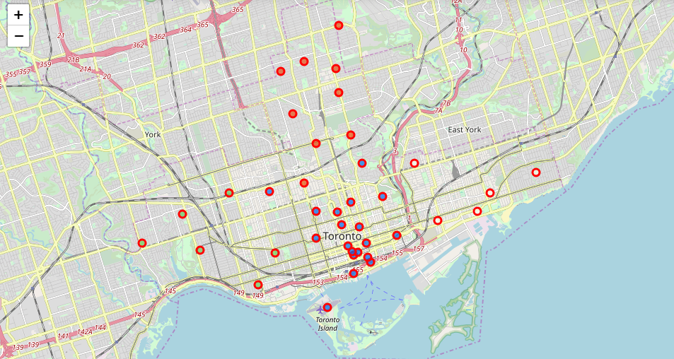
Locate the neighborhoods in Toronto

Slide 6
Results
Looking at the resultant clusters it is clear that
Cluster 0: group of the neighborhoods with medium popularity for Asian food
Cluster 1: group of the neighborhoods with high popularity for Asian food
Cluster 2: group of the neighborhoods with low popularity for Asian food

Slide 7

Results Recommended areas marked in red

Slide 8
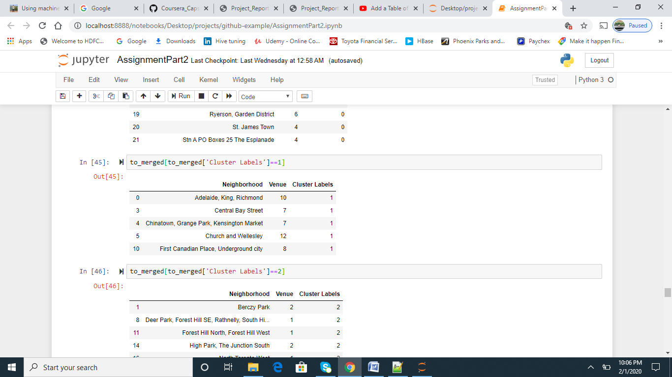
List of recommended areas

Slide 9
References
Wiki for postal code details.
Geospatial data for location details.
Foursquare API for venue details.

